Slide 1
Fit Logistic Regression Model to Tumor Homology Dataset
Dataset:
59 patients
32 with no benefits from treatment
27 with long-term benefits from treatment
59 Features – binary indicator variable of whether a patient’s tumor had a homology match with a specific infectious antigen.
Fitting Procedure:
Due to high dimensionality and small sample size, L1 (lasso) regularization will be used to avoid overfitting.
Use cross validation to select an appropriate lambda for the logistic regression
Fit logistic regression model with the selected lambda and use cross validation to find average test accuracy to assess model performance.
Other Considered Methods:
Random forest – low accuracy (~.55)
SVM – too flexible and over-fitted (58 support vectors)

Slide 2
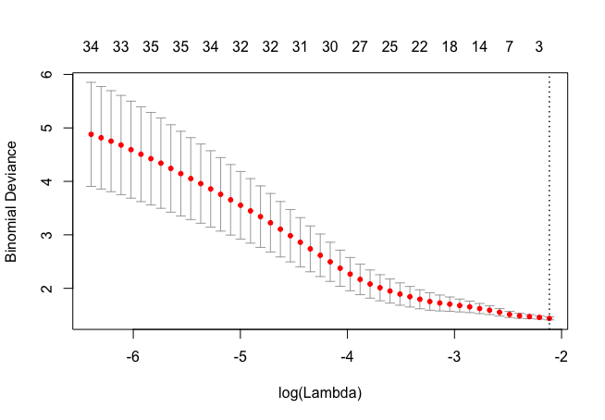
Validation Error vs Log(Lambda) & Number of Features
Log(lambda) = exp(-2.7) was selected since that’s when it the error plateaus off, and it will yield some non-zero coefficients for interpretation purposes.

Slide 3
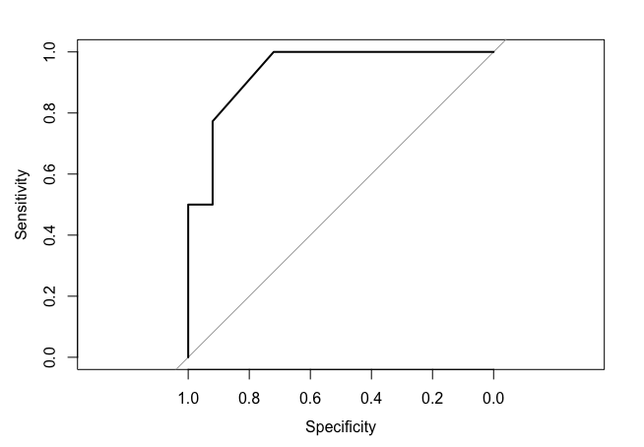
Train Model with Lambda and Evaluate Performance
Randomly sample 80% of the data as training set and fit the model. Use the remaining data points for testing.
ROC curve from a random sampling:
Testing validation was repeated 40 times to access the performance of the model. The area under the ROC curve and the balanced accuracy was recorded for each fold.
Average ROC area: .63
Average Maximum Balanced Accuracy: .71

Slide 4
Train Model with Lambda and Evaluate Performance
The prediction results were decent but not high enough for practical use. If a low probability threshold is selected to loosely recommend patients the treatment, there will be a higher chance that a patient will receive no long-term benefits.
The sample size is relatively small to the number of features, so there maybe inherent sampling bias from the patients. Homology matches from these patients may not affect the treatment results the same way as other patients.
The feature set is not very informative of the treatment results given the test performance, but it does support that there’s some relationship between tumor homology and treatment benefits. More patient data and more features may lead to better results.
Features/Antigens selected by the model.
BacillusAnthracis | -0.39575634
BordetellaPertussis | 0.82451183
BorreliaBurgdorferi | -0.60838954
BurkholderiaPseudomallei | 0.12982237
CTrachomatis | 0.04983483
FrancisellaTularensis | -0.2868449
HepatitisCVirus | 0.11539041
HTLV1 | 0.32463547
HumanHerpesvirus3 | 0.06884763
HumanHerpesvirus8 | -0.09048918
MeaslesVirus | -0.08784396
PorphyromonasGingivalis | 0.04256029
StreptococcusPyogenes | -0.36760382
YellowFeverVirus | 0.08050689

